Slide 1
Software Engineering 2022 Final Project Group 2

Slide 2
Project Members
AREA 1
Nico
Yassin
Martin
Miguel
AREA 2
Martin
Gerda
Norvydas
Gustas
AREA 4
Augustinas
Arnas
Gytis
Mažvydas
AREA 5
Viktar
Mindaugas
Petras
Jovilė
Shravani
Project Leader:
Martin Martijan
Supervisors:
Lekt. Virgilijus Krinickij
Lekt. Gediminas Rimša

Slide 3
Goal
Build an application that will provide the customer the information about where the solar panels can not be placed on the roof and how they should be attached depending on the part of the roof.
System will get XML with data about geometry of the roof faces. Ventilation setback area and wind-pressure zones of the panels will be calculated.
Finishing step: provide a visual representation for the above-mentioned calculations.
Company X is our client, and they will obtain a software system that will help company personnel create documents describing how exactly the solar system should be built.

Slide 4







Main Technologies Used

Slide 5
Implementation Plan
Distribute into teams by specific areas:
AREA 1 – extract and digest XML data.
AREA 2 – calculate ventilation setback area and pathway on the roof.
AREA 4 – calculate wind pressure zones.
AREA 5 – sum everything up into an application.

Slide 6
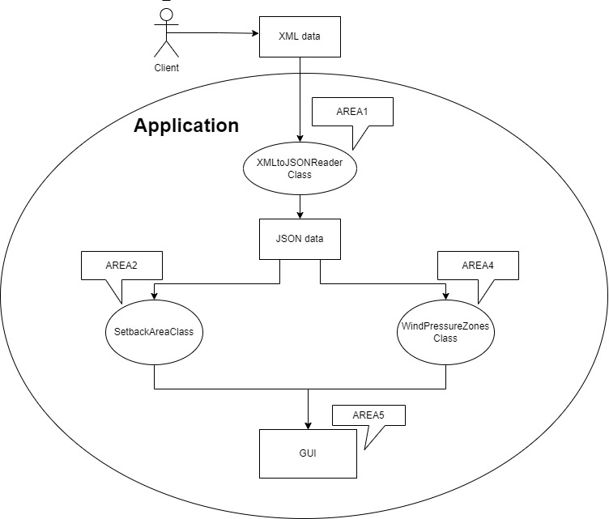

Slide 7
Deployment diagram

Slide 8
AREA 1
High overview scope:
Implement logic that takes a 3D model XML file produced by Company X, reads it, and extracts the information needed in the further solar system design process steps.
Members:
Nicolás Simarro
Yassin Aomar
Miguel Rodriguez
Martín Martínez

Slide 9
Objective of the code
The aim of our group code is to build a general application that provides the client with information about where solar panels cannot be placed on the roof and how they should be fixed depending on the part of the roof. To each area we have addressed a function.
Each area has a function addressed to it, the code of our area, which is named area1, must be able to import an XML file from any company in which the XML file will contain data about the geometry of the roof faces, and convert that file to JSON to extract the information needed for the next steps of the solar system design process.

Slide 10
Architectural decisions
We need only a 3D model file from any company.
3D model files store address information in them: Face, Line Point. And with the information we have to:
Find faces of the roof.
Find lines connecting to those faces.
Connect the points which are on one side of the roof
Work with vectors (calculations in code)

Slide 11
How We Did It?
We have created 4 modules:
Application:
AuxiliarFilesFunctions
LogControl
MainApplication
Classes:
Face
Import3dModel
Line
Location
Point
Polygon
Roof

Slide 12
Converters:
ModelToDTOConverter
XMLFileConverter
DTOs:
BaseDataDTO
FaceDTO
LineDTO
PointDTO
PolygonDTO
RoofDTO
RoofModelDTO

Slide 13
AREA 2
High overview scope:
Find the ventilation setback area on the roof and the pathway to that area.
Members:
Martin Martijan
Norvydas Martinka
Gerda Zykutė
Gustas Vasilevič

Slide 14
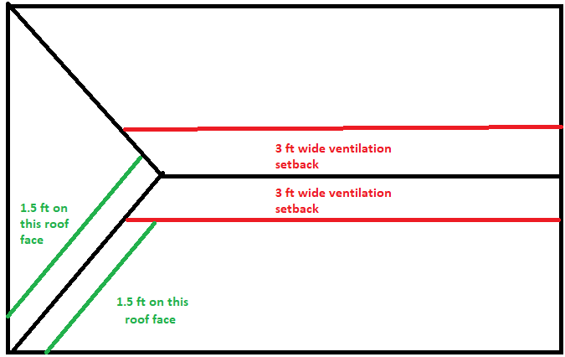
Scope (I)
Semi-complicated roof
– Setback area
– Pathway
– Edges

Slide 15
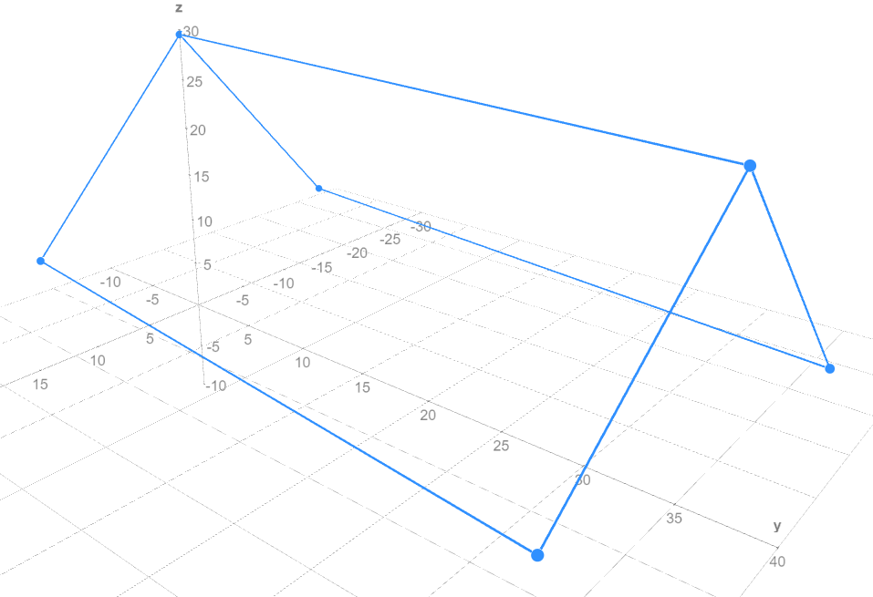
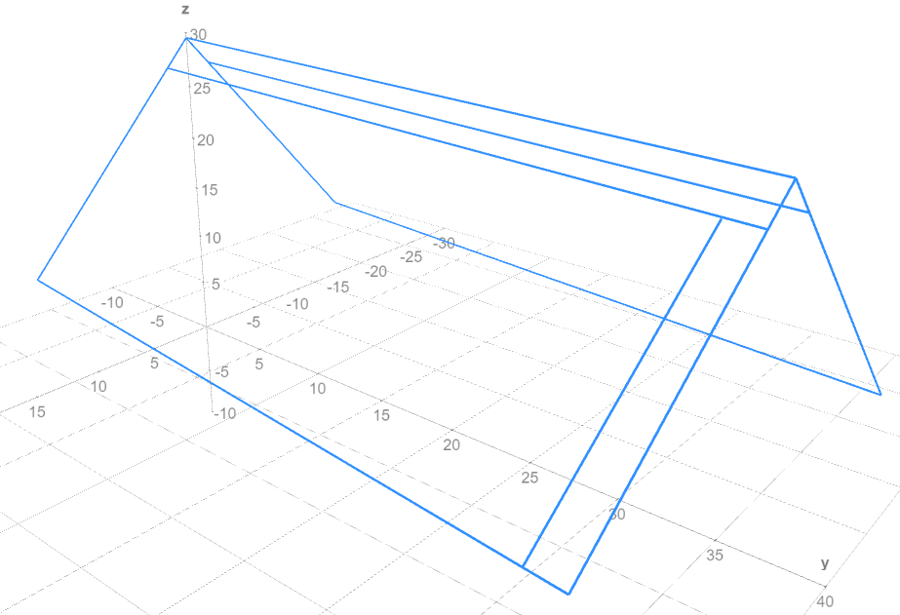
Scope (II)
ROOF: before calculations
ROOF: after calculations
Source: Math3d: Online 3d Graphing Calculator

Slide 16
AREA 4
High overview scope:
Find wind pressure zones on every roof face.
Members:
Augustinas Jažauskas
Arnas Čekanauskas
Mažvydas Poviliūnas
Gytis Sabaliauskas

Slide 17
AREA 5
High overview scope:
Tie all data into a PDF.
Members:
Viktar Breida
Petras Liubartas Rudys
Shravani Deshpande
Mindaugas Pumputis
Jovilė Kiršytė

Slide 18
Reflexion

Slide 19
CONTACTS

